Slide 1
New program manager orientation
BHS Quality Assurance

Slide 2
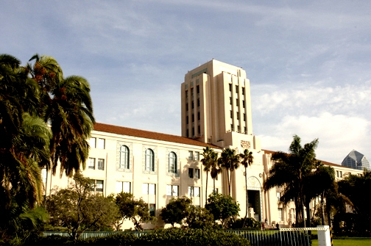
Welcome to
An introductory Orientation for new
program managers
This presentation offers a brief overview of several important topics related to program management and quality improvement in the County of San Diego’s Mental Health Plan (MHP).
It is an orientation and does not take the place of the various provider manuals that will be discussed.

Slide 3
Topics Covered
This orientation will cover the following topics:
    Federal and State statutes and regulations
    Documentation Requirements and Uniform Clinical Records
    Staff Requirements
    Highlights from the Organizational Provider Operations Handbook (OPOH)
    Quality Improvement Programs
    Beneficiary Satisfaction Surveys
    Confidentiality
    Beneficiary Grievances and Rights

Slide 4
Federal and State Regulations
regulations to be familiar with
Requirements for the following Federal and State regulations, as well as County policies and procedures, are an integral part of a program manager’s knowledge base.
    Federal Managed Care Regulations
    California Welfare & Institutions Code (W&IC)
    Mental Health Services Act (MHSA)
    The Civil Code of the State of California (CIV)
    California Health and Safety Code (HSC)
    California Education Code (EDC)
    Business and Professions Code (BPC)
    Title 9, California Code of Regulations, Chapter 11
    California's Medicaid State Plan (Title XIX)
    California State Plan Amendment - Number 10-012B (SPA)
    Code of Federal Regulations, Title 42 (42 CFR)
    Health Information Portability and Accountability Act (HIPAA)
    Title VI, Civil Rights Act of 1964

Slide 5

County Policies and Procedures
The County of San Diego Health and Human Services Agency (HHSA) is the broader agency that includes Behavioral Health Services. All County and County Contract program managers should be familiar with the following policies and procedures.
    Agency Compliance Office (ACO) policies and procedures
    HHSA Code of Conduct
    Outpatient Program Operations Handbook (OPOH)
    Uniform Clinical Record Manual (UCRM)
This Photo by Unknown Author is licensed under CC BY

Slide 6
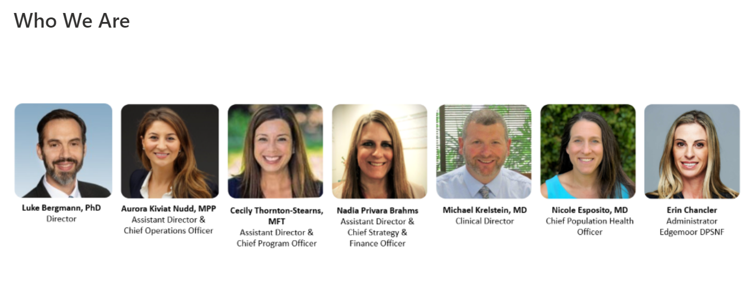
San Diego County mental health services Leadership
San Diego County ( The County)
  Chief Administrative Officer (CAO) is Helen N. Robbins-Meyer
  Assistant CAO/Chief Operating Officer (COO) is Donald F. Steuer
Health and Human Services Agency (HHSA)
  HHSA Agency Director is Nick Macchione, MS, MPH, FACHE
  Within HHSA is Luke Bergmann, Ph.D. Director of Behavioral Health Services

Slide 7

What else do you need to know?
Resources:
  One of the best places to find information about what is required is your contract.
    Your program’s assigned Contracting Officer’s Representative (COR)
    BHS Outpatient Program Operations Handbook (OPOH)
    QI Matters email at QIMatters.HHSA@sdcounty.ca.gov
    Optum San Diego at Optum Website MHP Provider Documents

Slide 8
Common Abbreviations
AOA – Adult and Older Adult
CYF – Children Youth and Families
EPSDT – Early Periodic Screening Diagnosis and Treatment
EPU - Emergency Psychiatric Unit (Adults and Older Adults)
ESU - Emergency Screening Unit (Children and Adolescents)
MHP - Mental Health Plan
MHSA - Mental Health Services Act
QA - Quality Assurance
SDCBHS - San Diego County Behavioral Health Services
SDCPH - San Diego County Psychiatric Hospital
SIR - Serious Incident Report
SMHS - Specialty Mental Health Services
SOC – System of Care
SUD - Substance Use Disorders Services

Slide 9





Target populations
children, Youth, families, Adults and Older Adults

Slide 10
Target population
Who do we serve?
Persons with Medi-Cal
Persons with no insurance
Low Income Individuals who may have other 3rd party insurance such as Medicare
Through the California Advancing and Innovating Medi-Cal (CalAIM) Initiative and Assembly Bill (AB) 133 access criteria has expanded for eligible beneficiaries

Slide 11
California advancing and innovating medi-cal initiative
    CalAIM is a significant transformation designed to reform several aspects of the California Medi-Cal system including
      Documentation
      Access to Services
      Service Delivery and Coordination of Care
      Payment Reform
      No Wrong Door Policy

Slide 12
Where to find information
Updates to are sent out through California Department of Health Care Services (DHCS) Letters and Informational Notices which can be found on the DHCS website.
    DHCS Informational Notices
    CalAIM
    Managed Care All Plan Letters
    You can also refer to the San Diego County of Memo that was published on 8.15.2022 BHS Contractor Memo-CalAIM Documentation Reform (pdf) (optumsandiego.com)

Slide 13
Where to Find information
Behavioral health information notice (bhin) 22-019
Outlines Requirements for:
  Standardized Assessment Requirements
  SMHS, DMC, and DMC-ODS Problem List
  SMHS, DMC and DMC-ODS Progress Notes
  Treatment and Care Planning Requirements
  Telehealth Consent

Slide 14
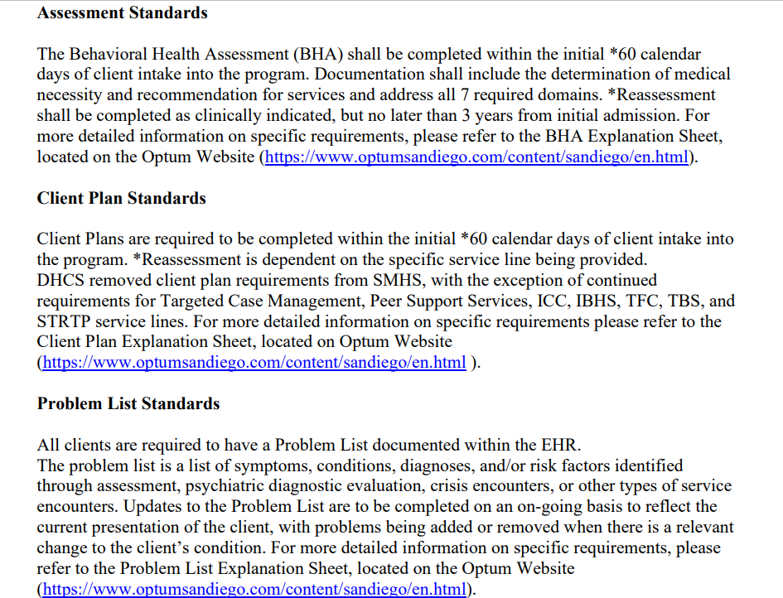
Section d of the opoh
County specific guidelines
07 – OPOH – Section D – Providing Specialty Mental Health Services (pdf) (optumsandiego.com)

Slide 15
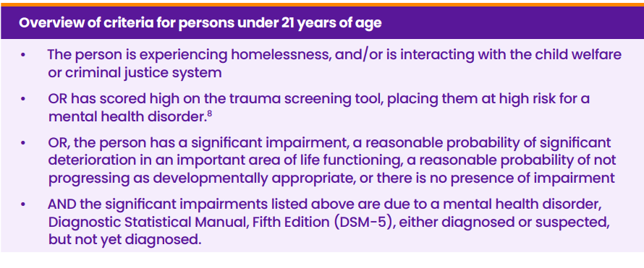
access criteria for under 21
Please refer to (BHIN) No: 21-073
DHCS is still developing trauma screening tools

Slide 16
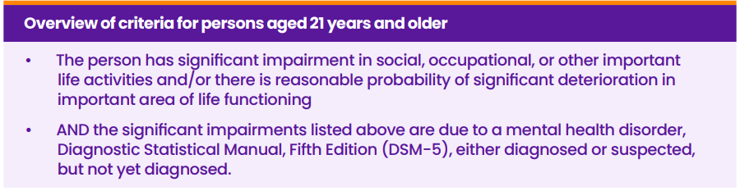
access criteria for over 21
Please refer to (BHIN) No: 21-073

Slide 17
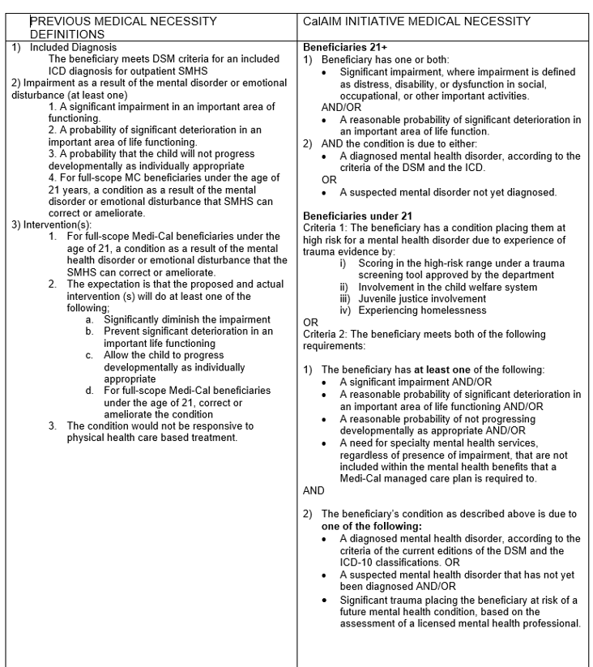

Slide 18
Utilization Review Process
Mental Health Services has developed standards for Utilization Review
and/or Utilization Management(UR/UM).
The processes vary for:
  Adults and Older Adults System
  Children, Youth and Families
Program Managers are responsible for ensuring that their programs
are following the UR/UM Standards.
Please check with your COR to ensure you have the latest information
or refer to the Organizational Provider Operations Handbook (OPOH)
Section D.

Slide 19

Documentation Standards

Slide 20
Learning about Documentation Standards
Familiarity with Documentation Standards is a critical function of all Program Managers as services are billed to the State and federal government. All documentation must adhere to minimum standards to reduce the risk of compliance issues.
Services must document how the intervention or service will address the person in care’s identified behavioral health need alongside meeting criteria for continued access to services.
Where do new program managers and clinical staff turn for information on documentation?
  Uniform Clinical Record Manual, QM Documentation Trainings, and the CalMHSA Documentation Guides/Trainings

Slide 21
The Uniform Clinical Record Manual (UCRM)
This manual is the complete guide to documentation in the County of San Diego mental health system.
  It is the resource for information on forms, documentation timelines and documentation standards.
  Only forms from the manual (or those created by QM) should be used. Exceptions to the Manual must be approved by the QM Unit.
  The Uniform Clinical Record Manual can be found on the Optum San Diego website (click on the UCRM tab)

Slide 22
Documentation Training
There are multiple documentation training opportunities offered by QM and Optum:
  Audit Leads – Learn how County QM conducts MRRs (For PMs and QA staff).
  Mental Health Providers – Real-time practice writing progress notes with County QM feedback and support (For all direct service staff).
Documentation Webinars and tutorials available on the Optum San Diego website. (click on the Training tab)
  NOABD, Service Indicators, Access to Services Journal

Slide 23

Staff Requirements

Slide 24
Staff Requirements
In order for staff to provide services, several criteria must be met:
  Clinical Staff must have an NPI (National Provider Identifier ) number.
    The NPI is a unique identification number for covered health care providers.
    The NPI is a HIPAA requirement

Slide 25
Staff Requirements
For questions on how to obtain an NPI, you can:
  Phone: 1-800-465-3203 or TTY 1-800-692-2326
  E-mail: customerservice@npienumerator.com
  Mail:
  NPI Enumerator
  P.O. Box 6059
  Fargo, ND 58108-6059

Slide 26
Staff Requirements
CalMHSA Trainings for MHP for CalAIM
• All clinical staff registered in CCBH are required to complete the trainings as well as supervisors and managers of clinical registered CCBH users.
• Registered clinical users are required to complete the following CalMHSA trainings:
o CalAIM Overview
o Screening
o Assessment
o Transition of Care Tool
o Diagnosis & Problem List
o Progress Notes
o Discharge Planning
o Access to Service
  o Care Coordination
• Trainings shall be completed by 2/15/2023. QA is monitoring attendance monthly.
Reminder: Please ensure you are checking the most recent documentation manuals on the CalMHSA website as they are updated to ensure that the most recent information is included.

Slide 27
Staff Requirements
CalMHSA Documentation Trainings
CalMHSA has been collaborating with DHCS on the integration of CalAIM requirements and documentation standards. Part of their process has been to create training guides and videos to support counties in implementation of updated documentation standards. The County is asking that staff listed below review the documentation guidelines, which can be found here: California Mental Health Services Authority | CalAIM (calmhsa.org). The following are additional items that can be found on the CalMHSA website geared to support providers with the roll out of the CalAIM initiative:
CalAIM Communication Materials
• Communication Materials for Staff
• Communication Materials for People in Care
• Communication Materials for People in Care (Spanish)

Slide 28
Staff Requirements
CalMHSA Documentation Trainings (continued)
CalAIM Documentation Guides, Web-Based Trainings & Training Dashboard
Documentation Guides
• MH Clinical Staff
• MH Certified Peer Support Specialists
• MH MHRS & Other Staff
• MH Medical Staff
  • SUD Clinical Staff
• SUD Certified Peer Support Specialists
• SUD AOD Counselors
• SUD Medical Staff
Training Dashboard
• Option to “Download data” (into an Excel spreadsheet) at the bottom of the webpage

Slide 29
Staff Requirements
CalMHSA Documentation Trainings (continued)
CalAIM Policies & Procedures and Attestations
• P&P Attestation for BHINs 21-071, 21-073 & 21-075
• P&P Attestation for BHIN 22-011 No Wrong Door
• P&P Attestation for BHIN 22-019 Documentation requirements for all SMHS, DMC, and DMC-
ODS Services
• Medical Necessity Determination and Level of Care Determination
• Requirements for Drug Medi-Cal (DMC) Treatment Program Services (BHIN 21-071)
• Criteria for Beneficiary Access to SMHS, Medical Necessity and Other Coverage
Requirements (BHIN 21-073)
• Drug Medi-Cal Organized Delivery System Requirements for the period of 2022-2026
(BHIN 21-075)
• Documentation Requirements for all SMHS (BHIN 22-019)
• No Wrong Door (BHIN 22-011)

Slide 30
Staff requirements
Requirements for Programs that May Serve Clients with Medicare
Programs are required to have approved Medicare Provider Numbers known as PTAN for Psychiatrist, LCSW, Licensed Psychologist and Nurse Practitioners
Programs must have Medicare eligible providers to provide services
CMS 855 I and CMS 855R are required to be completed and submitted to the Medicare Intermediary Noridian
There are specific documentation requirements for Medicare

Slide 31

Staff Requirements
Staff must also have access to the County’s Management Information System (MIS), which is called CCBH and must also have a CCBH Staff ID
To gain access to CCBH, staff must:
  Submit an “ARF” (Access Request Form) by the program manager and send it to the MIS unit to receive staff CCBH ID and CCBH Password (Program Managers are also responsible to notify the MIS unit when staff terminates, so they no longer have access to CCBH.)

Slide 32
Staff Requirements
Staff are required to attend EHR training sessions as they apply to their job function:
  For example, clinical staff will learn how to enter Behavioral Health Assessments (BHAs), Client Plans and Progress Notes into CCBH
  Trainings are provided through Optum San Diego
  You can register staff through their Training Page, and it provides helpful information on pre-training and post-training material
  CCBH Training (optumsandiego.com)

Slide 33
Staff Requirements
Clinical staff that can provide mental health services:
Physician
Licensed Psychologist (or licensed waivered Psychologist)
Licensed Clinical Social Worker (or registered ASW)
Licensed Marriage and Family Therapist (or registered AMFT)
Licensed Professional Clinical Counselor (or registered APCC)
Master’s level student interns (Trainees)
Registered Nurse
Mental Health Rehabilitation Specialist (MHRS)
Para-professionals
It is a Program Manager’s responsibility to ensure that all staff are licensed, registered or waivered and/or receive appropriate co-signature on documentation.

Slide 34

Staff Needing a waiver
Each CA licensed psychologist candidate and/or LCSWs or LMFTs from out of state must obtain a license waiver.
          Psychologists are waivered for 5 years
          Out of state Waivers are only effective for 3 years

Slide 35

Important staff information
LCSW and LMFT candidates must remain registered with his/her licensing board until such time the candidate is licensed.
For LCSW/LMFT candidates, no waiver is needed, nor can one be obtained; the only exception pertains to license-ready candidates recruited from out of state.
Masters level student interns (Trainees) may provide mental health services as long as they receive appropriate supervision and have their work co-signed based on requirements found in the Uniform Clinical Record Manual (UCRM)

Slide 36

Staff Requirements
Credentialing and Recredentialing
All Direct Service Staff who participate in San Diego County Behavioral Health Plan (SDCBHP) must be credentialed/re-credentialed according to SDCBHP requirements.
Discuss the credentialing process with your legal entity to obtain more information on the specific requirements.

Slide 37

Staff Requirements
Credentialing and Recredentialing
Initial Credentialing:
  Complete Optum’s on-line application by calling the Behavioral Services Credentialing Department at (800) 482-7114 or by sending a notification email to BHSCredentialing@optum.com
Re-credentialing:
  Individual practitioners and Residential Programs Sites undergo recredentialing every three (3) years.
  Re-credentialing will begin approximately six (6) months prior to the expiration of the credentialing cycle.

Slide 38
MEG REGS/NETWORK Adequacy:
System of care application
As part of Network Adequacy Requirements ( BHIN 22-032 and 22-033) providers have been asked to utilize the System of Care (SOC) application to collect the information needed to assist with County routine submission
  Program Managers and Providers are required to attest to all SOC information monthly
  New staff and transfers are required to register promptly and attest to information once registration is complete.
    For tips, FAQs, and additional information
    SOC Tips and Resources (optumsandiego.com) or email sdhelpdesk@optum.com

Slide 39

A must read for new program managers…
Organizational Provider
Operations Handbook (OPOH)
The current Version is found on the OPTUM San Diego Website
OPOH – Organizational Providers Operation Handbook (pdf) (optumsandiego.com)
OPOH

Slide 40
OPOH Highlights
This is a guide for all program managers with information needed for running your program.
It contains specific requirements for a program.
This handbook provides references and referrals for further assistance.
Each chapter will provide you with valuable information so, let’s get started.

Slide 41
OPOH Highlights
  Chapters in the Handbook:
    Systems of Care
    Compliance and Confidentiality
    Accessing Services
    Providing Specialty Mental Health Services
    Integration with Physical Health Care
    Beneficiary Rights, Grievance and Appeals
    Quality Management Program
    Cultural Competence
    Management Information System
    Provider Contracting

Slide 42
OPOH Highlights
  Chapters in the Handbook (continued):
      Provider Issue Resolution
      Practice Guidelines
      Staff Qualifications and Supervision
      Data Requirements
      Training
      Mental Health Services Act – MHSA
      Payment Schedule and Budget Guidelines for Cost Reimbursement
      Quick Reference Guide
      List of Appendices

Slide 43
The (OPOH) details
Important qm requirements
Internal Quality Improvement Controls and Activities
Medical Record Requirements
Quality Management & Short-Doyle Medi-Cal Requirements
Staff Signature Logs
Medi-Cal Recoupment and Appeals Process
Medi-Cal Site Reviews
Medication Monitoring Process
Accessibility of Services/Wait Times
Client and Performance Outcomes
Reporting Serious Incidents
Provider transfer request

Slide 44
Financial manual
Each program is responsible to have a copy of the Financial Eligibility and Billing Procedures – Organizational Providers Manual
It provides detailed instructions for completion of financial eligibility and billing processes including entry of third-party coverage and financial reviews (UMDAP), billing and recording of payments.
The manual is available on the Optum website:
  Financial Eligibility and Billing Manual (pdf) (optumsandiego.com)

Slide 45
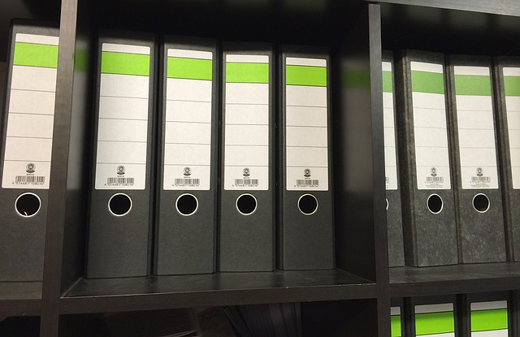
Medical record
Programs are required to use the CCBH EHR or current forms found in the Uniform Clinical Record Manual as needed.
Medical Records are a hybrid chart, as some documentation will be maintained in a paper chart.
All records must be maintained in a secure location, filed in a prescribed order, and be retrievable for audits by QM, DHCS or other entities

Slide 46
Quality Management & Short-Doyle Medi-Cal Requirements
Programs will be monitored for quality and compliance by the BHS Quality Assurance Unit.
Medical Record Reviews occur annually
Medication Monitoring occurs quarterly
Medi-Cal site certifications occur initially and every three years for site re-certification
The QA unit monitors trends and/or patterns that may result in quality improvement recommendations

Slide 47
Staff Signature Logs
A Signature Log is a list of all current staff providing direct services, their licensure, job title, and a copy of their typical signature.
All organizational providers are required to maintain an accurate and current staff signature log.
Logs must reflect any changes in staff licensure, degree, job title, name, or signature.
Logs shall be made available at request of QM or DHCS during reviews, visits, etc.

Slide 48
Medi-Cal Recoupment and Appeals Process
Billings will be disallowed that do not meet documentation standards in the Uniform Clinical Record Manual.
Per the current California State DHCS Reasons for Recoupment of FFP Dollars, MHP is obligated to disallow Medi-Cal claims under:
  Related to Fraud, Waste, and Abuse
  Medical necessity
  Progress notes

Slide 49

Medi-Cal Recoupment and Appeals Process
Progress Note Disallowances:
      No Progress Note or no narrative for a service claimed
      Time billed for the service is greater than the time documented
    Billing service time for a “No Show” when no service was provided
    No SMHS was provided - Service provided was solely academic, vocational, recreation, socialization or supportive service only.
    The service was not provided within the scope of practice of the person delivering the service.
    Progress note was not signed (or electronic equivalent) by the person(s) providing the service
    Service provided were ineligible for FFP (Federal Financial Participation) or in setting subject to lockouts (i.e. service provided while client was in an IMD, Jail, Juvenile Hall, etc.)

Slide 50
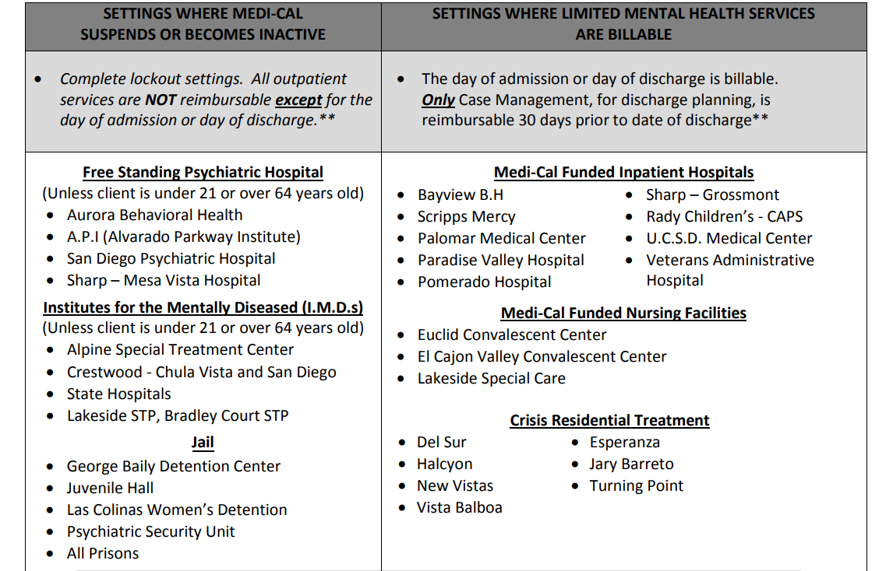
Medi-Cal Recoupment: Progress Note disallowances

Slide 51
Medi-Cal Recoupment and Appeals Process
If a provider disagrees with a recoupment, there is a 2-level process for appealing (found in the OPOH under Quality Management Program section).
Included is a description of the process with timelines for first and second level appeals.

Slide 52
Medi-Cal Site reviews
Types of site Reviews include:
Medi-Cal certification and recertification
The protocol for these reviews is available on the Optum San Diego website. (This link takes you to the MHP Provider Documents page. From here, click the References tab. Then, click on the document titled Medi-Cal Certification Recertification Tool)

Slide 53
Medi Cal site review:
Physician notice posting
Per Business and Professions Code section 138, all California physicians and surgeons are required to inform their patients that they are licensed by the Medical Board of California and must include the Board's contact information. The information must read as follows:
NOTICE TO CONSUMERS
Medical doctors are licensed and regulated by the Medical Board of California
(800) 633-2322
www.mbc.ca.gov
The purpose of this new requirement (Title 16, California Code of Regulations section 1355.4) is to inform consumers where to go for information or with a complaint about California medical doctors.

Slide 54
Physician notice posting continued
Physicians may provide this notice by one of three methods:
Prominently posting a sign in an area of their offices conspicuous to patients, in at least 48-point type in Arial font. (See link "Sign for printing", below, to print the actual notice.)
Including the notice in a written statement, signed and dated by the patient or patient's representative, and kept in that patient's file, stating the patient understands the physician is licensed and regulated by the board.
Including the notice in a statement on letterhead, discharge instructions, or other document given to a patient or the patient's representative, where the notice is placed immediately above the signature line for the patient in at least 14-point type.
16 CCR § 1355.4 § 1355.4. Notice to Consumers

Slide 55
Board of behavioral sciences (BSS) notice to psychotherapy patients
Updated requirements
Requirement Changes as of January 1, 2022
    New language around timing to allow for a provider to provide services in an emergency first. “For new clients, you are required to provide this notice prior to initiating psychotherapy services, or as soon as practicably possible thereafter.”
    For new clients that you see as of January 1, 2022, you are required to document in the client’s record that you delivered the notice.
    If you are unlicensed or unregistered with the board practicing in an exempt setting you are required to provide a notice about how to file a complaint with your agency
    Updated Requirement To Provide Notice To Psychotherapy Clients (ca.gov)

Slide 56

Medication Monitoring
All providers with programs prescribing medications are required to have a medication monitoring system.
Programs are required to review one percent (1%) of their active medication caseload each quarter, with a minimum of one chart reviewed.

Slide 57
Medication Monitoring
Programs shall use the Medication Monitoring Report, Medication Monitoring Screening tool, and the Medication Monitoring Feedback Loop (McFloop) for their screening.
Results of medication monitoring activities are reported quarterly to the QM unit by the 15th of each month following the end of each quarter, for example Q1 is October 15th. These are submitted to qimatters.hhsa@sdcounty.ca.gov
Refer to OPOH, Quality Improvement Program Section for full Medication Monitoring process.

Slide 58

Access to services

Slide 59
Accessibility of Services/
Access Times
Access to Services Journal (ASJ) must be maintained by all Outpatient Programs
  This information is reported to the State to ensure that clients receive services in a timely manner – emergent, urgent, and routine.
State standards for Access Times are as follows:
  Psychiatry - within 15 business days from request to appointment.
  Mental Health Services - within 10 business days from request to appointment.
  Urgent – within 48 hours of determining the client needs urgent services.
  Emergent – within 1 hour . Title 9 defines an “Emergency Psychiatric Condition” as a condition in which the client, due to a mental disorder, is an imminent danger to self or others or is immediately unable to provide for or utilize food, shelter, or clothing.

Slide 60
Accessibility of Services/
Access Times
What are Access Times?
Timely access refers to the number of business days in which an appointment is available to a client from the date the client requests a service.
  This is based on availability whether or not the person requesting the service accepts the offered appointment. For example, if the person calls on 1.2.23 and the program offers appointments on 1.5.23, 1.10.23, and 1.20.23 but the person is only able to attend the last appointment on 1.20.23 this would still meet the requirements as it is based on availability of the program.
This measures our efficiency as a Mental Health Plans (MHP).
Wait time is reported monthly to QM. Access times are monitored by the Performance Improvement Team (PIT) of County Quality Improvement
For further information, consult your OPOH and/or your COR.

Slide 61

Client and Performance Outcomes
State surveys occur during a two-week time period twice a year.
Surveys are to be completed by all outpatient providers, including case management.
Surveys include client satisfaction surveys.
HSRC/CASRC are responsible for handling the survey process.

Slide 62
Client and Performance Outcomes
Programs must follow the current guidelines for administrating client outcome tools.
Please check with your COR if you need more information
San Diego County Adult Outcome Measures Manual can be found here on the Optum website.
  or mHOMS for Children’s outcomes at https://mhoms.ucsd.edu/

Slide 63
Serious Incident Reports (SIR)
Providers are required to report serious incidents involving clients in active treatment or who were discharged within past 30 days.
Required reports shall be sent to BHS Quality Management Team
Initial Serious Incident Report is to be submitted within 72 hours for a level 2 and within 24 hours for a level 1.
Serious Incident Report Follow-up is submitted 30 days from the date program was notified of the incident
Provider shall also notify appropriate authorities. The forms for reporting are found at Optum San Diego. (This link takes you the MHP Provider Documents page. From there, click on the Forms tab. Then, Click on the document titled BHS Serious Incident Report).

Slide 64
Unusual occurrences
An unusual occurrence is an incident that may indicate potential risk/exposure for the program, client, or community.
Examples include the following:
  Alleged child abuse, Police involvement, Inappropriate sexual behavior, Self-injury, Physical injury, Physical abuse, AWOL, Fire setting, Poisoning, Major accident, Property destruction, Epidemic or other infectious disease outbreak, Loss or theft of medications from facility
When one occurs, appropriate agencies are to be notified within specified timeline and format.
  Providers are required to notify their COR within 24 hours when an unusual occurrence takes place.

Slide 65
Privacy Incident Reports (PIR)
If suspected or actual privacy incident involves 500 or more individuals, notify Agency Privacy Officer (APO) immediately by emailing:
Christy.Carlson@sdcounty.ca.gov
For all other suspected or actual privacy incidents, follow steps below:
Submit Privacy Incident Report (PIR) online via the web portal: https://www.sandiegocounty.gov/content/sdc/hhsa/hhsa-privdb-landing.html within one business day.
After you submit the PIR, you will receive an email with the PIR Tracking # and an Access Code. This is used to access your PIR via the same web link above.
Continue to investigate and update the PIR online within 72 hours, including required information missing from initial report and any additional information requested by APO.
Provide any pending or additional information needed to submit Final completed PIR within seven business days of initial discovery.

Slide 66

HIPAA Regulations
Handling/Transporting Medical Record Documents outside Certified Clinics
    Medical Record
    Laptop which contains client information
    (see OPOH on Compliance and Confidentiality)
Confidentiality Breaches
  State laws and regulations effective January 1, 2009. HITECH requires notification to patients “without reasonable delay” but no later than 60 days after discovery of a privacy breach. (See Compliance and Confidentiality)

Slide 67

Serving clients
The final section of this orientation relates to the client issues of:
    Client Grievances and Appeals
    Beneficiary Rights
    Communications/Resources

Slide 68
Beneficiary rights
Clients have the right to:
Be treated with personal respect with dignity and privacy.
Receive information on available treatment options and alternatives presented in a manner they understand.
Participate in decisions about their mental health care.

Slide 69
Beneficiary rights
Clients have the right to:
Receive informing materials about the services covered by the Mental Health Plan (MHP).
Request and receive a copy of their medical records and request they be amended or corrected.
Be free from any form of restraint or seclusion as specified in federal rules.
Write an Advance Directive covering their mental health care.
Refuse treatment

Slide 70
Beneficiary rights
Clients are encouraged to direct their concerns, complaints or suggestions to program staff or management, orally or in writing. These are to be reported in the MSR/QSR as a suggestion on the Suggestion & Transfer tab.
Providers shall inform all clients about their right to file a grievance with one of the MHP’s contacted advocacy organizations if the client has an expression of dissatisfaction about any matter, is uncomfortable approaching program staff, or the dissatisfaction has not been successfully resolved at the program.
Grievance and Appeal information must be readily available for clients to access without the need for request. Each provider site shall have posters, brochures, and grievance/appeal forms in threshold languages with stamped, addressed envelopes available to clients, displayed in a prominent place. These self-addressed envelopes with postage are available from CCHEA or JFS respectively.

Slide 71
Client Grievance and appeals
If clients are not able to resolve their concern at the program level, or want to appeal a decision that limits care, they should be assisted to contact one of the agencies listed below.
For problems with inpatient or 24-hour residential services, call the IP Patient Advocate (JFS) at 800.479.2233 or locally at 619.282.1134. For more information visit their website https://www.jfssd.org/our-services/adults-families/patient-advocacy/
For problems with outpatient and any other type of mental health service, call the Consumer Center for Health, Education and Advocacy (CCHEA) at 877.734.3258 or visit their website https://www.lassd.org/about/what-cchea

Slide 72

Clients complaints or grievances
There can be absolutely no retribution or retaliation against a client or family member who has filed a complaint or grievance against a program or staff

Slide 73
Provider transfer and Continuity of Care request
Clients have a right to request a transfer from one Medi-Cal provider to another within or outside of a program.
  If a client requests a change in providers, it must be documented in the Monthly Status Report (MSR) or Quarterly Status Report (QSR) under the Client Suggestions & Transfer Requests.
Clients have the right to request Continuity of Care. This is a transition plan which ensures the client has continued access to care when transitioning from a pre-existing Medi-Cal out of network provider to a provider within our MHP.
  Clients must be given the option to continue treatment with an out-of-network Medi-Cal provider for a limited amount of time.
  Optum manages all Continuity of Care requests for our MHP.

Slide 74

Monthly and Quarterly
Status Reports (MSRs/QSRs)
MSRs/QSRs are required from each program, county or contract, by the 15th of month.
Required by CORs
For more information contact your COR or their designated analyst.

Slide 75

Up to the Minute (UTTM)
QM publishes the UTTM monthly newsletter to inform providers of important changes to regulations and/or requirements.
Includes knowledge sharing, Optum website changes, OPOH updates, MIS information, trainings and events, and other key information.
It is the Program Managers responsibility to disseminate the information to line staff.
To be added to the email distribution list send a request to QIMatters.HHSA@sdcounty.ca.gov

Slide 76

Communications
Quality Improvement Partners (QIP) Meeting
QM facilitates the monthly QIP meeting to discuss important regulatory and/or requirement changes.
Program Managers and QA staff are encouraged to attend.
The meeting is held on the 4th Tuesday of every month from 2pm – 4pm.
Attendance is virtual. See the UTTM for further details.

Slide 77
Communications
  The County QA Unit: For documentation and other QM related questions
      email: QIMatters.hhsa@sdcounty.ca.gov
    For Optum of San Diego
      See https://www.optumsandiego.com
      The Optum Helpdesk: (800) 834-3792. For questions related to using CCBH, or assistance accessing their Public Sector Website.
      The BHS Fiscal Billing Unit: (619) 338-2612. For assistance with financial questions.

Slide 78
QA Team contact information
  QA Supervisors
  Elaine Mills
    619-964-3644 elaine.mills@sdcounty.ca.gov
  Jill Michalski
    619-206-0320 Jill.michalski@sdcounty.ca.gov
  Danielle Rhinesmith
    (619) 584-3098 Danielle.rhinesmith@sdcounty.ca.gov
  QA Behavioral Health Program Coordinator
    Heather Parson
      (619) 584-5016 Heather.parson@sdcounty.ca.gov
  QA Unit Administrator
    Tabatha Lang
      (619) 563-2741 Tabatha.lang@sdcounty.ca.gov

Slide 79

This Photo by Unknown Author is licensed under CC BY

